Slide 1
Acid Nomenclature

Slide 2
Acid Nomenclature
Acids
Compounds that form H⁺ in water.
Formulas usually begin with ‘H’.
In order to be an acid instead of a gas, binary acids must be aqueous (dissolved in water)
Ternary acids are ALL aqueous
Examples:
HCl _{(aq)} – hydrochloric acid
HNO₃ – nitric acid
H₂SO₄ – sulfuric acid

Slide 3
Acid Nomenclature Review
No Oxygen→
w/Oxygen
An easy way to remember which goes with which…
“if you ate something bad your goanna say ic and if its really bad you may get hepa-tite-ous

Slide 4
Acid Nomenclature Flowchart

Slide 5
Acid Nomenclature
HBr _{(aq)}
H₂CO₃
H₂SO₃
2 elements, -ide
⇒ hydrobromic acid
3 elements, -ate
⇒ carbonic acid
3 elements, -ite
⇒ sulfurous acid

Slide 6
Acid Nomenclature
hydrofluoric acid
sulfuric acid
nitrous acid
2 elements
⇒ H⁺ F-
⇒ HF _{(aq)}
3 elements, -ic
⇒ H⁺ SO₄²⁻
⇒ H₂SO₄
3 elements, -ous
⇒ H⁺ NO₂⁻
⇒ HNO₂

Slide 7
Name ‘Em!
HI _{(aq)}
HCl
H₂SO₃
HNO₃
HIO₄

Slide 8
Write the Formula!
Hydrobromic acid
Nitrous acid
Carbonic acid
Phosphoric acid
Hydrotelluric acid

Slide 9
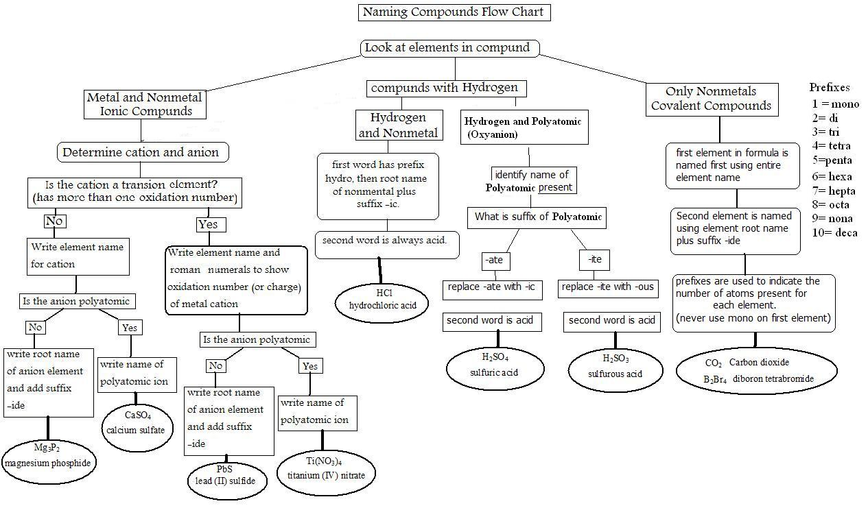

Slide 10
Formulas to names
If the name has
Acid in the name: MUST balance charges
Hydroiodic acid
2 elements H⁺¹ and I⁻¹
HI
Sulfuric acid
More than 2 elements
Polyatomic ions: ate to ic, ite to ous
H⁺¹ and SO₄⁻²
H₂SO₄

Slide 11
Formulas to names
If the name has
Prefixes: JUST write what it says
Carbon dioxide
CO₂
Roman numbers: MUST balance charges
Vanadium (IV) sulfide
V⁺⁴ S⁻²
VS₂
Iron (III) sulfide
Fe⁺³ S⁻²
Fe₂S₃
Metal: MUST balances charges
Calcium phosphate
Ca⁺² PO₄⁻³
Ca₃(PO₄)₂

Slide 12
Rainbow Matrix Game
Link on Chemistry Geek.com on Chemistry I page
http://chemistrygeek.com/rainbow
Use [ ] to represent subscripts since you can’t enter subscripts into the computer
So H₂O would be H[2]O
And Al₂(SO₄)₃ would be Al[2](SO[4])[3]
Borate = BO₃ ⁻³ ; Silicate = SiO₄ ⁻⁴ ; Manganate = MnO₄ ⁻² (permanganate is -1)

